Slide 1
EMPLOYEE DATA ANALYSIS USING EXCEL
STUDENT NAME : SONPARI KUMARI P
REGISTER NO : 2213391036325 ,
46963224646FDD9B6344894B1EA80EC0
DEPARTMENT : B.COM(COMMERCE)
COLLEGE : QUEEN MARY’S COLLEGE

Slide 2

PROJECT TITLE
Employee Overtime Pay Analysis using Excel

Slide 3

AGENDA
Problem Statement
Project Overview
End Users
Our Solution and Proposition
Dataset Description
Modelling Approach
Results and Discussion
Conclusion
3/21/2024 Annual Review

Slide 4

PROBLEM STATEMENT
Analyze the trends and patterns of overtime pay among employees to identify areas of inefficiency, ensure compliance with labour regulations, and inform data-driven decisions to optimize staffing, scheduling, and compensation practices, ultimately reducing overtime costs and improving workforce productivity."

Slide 5

PROJECT OVERVIEW
Review of existing overtime pay policies and procedures- Analysis of historical overtime pay data- Identification of factors contributing to overtime pay- Comparison with industry benchmarks and best practices- Development of recommendations for improvement

Slide 6

WHO ARE THE END USERS?
Employees: Who work extra hours beyond their regular schedule and are entitled to receive overtime pay.
HR Personnel: Responsible for tracking employee work hours, processing overtime pay, and ensuring compliance with labor laws and regulations.
Payroll Staff: Who calculate and disburse overtime pay to eligible employees.
Managers and Supervisors: Who authorize overtime work, monitor employee hours, and ensure that overtime pay is accurately processed.
Business Owners/Leaders: Who oversee the organization's labor costs, including overtime pay, and make strategic decisions about workforce management.

Slide 7

OUR SOLUTION AND ITS VALUE PROPOSITION
Conditional formatting - Highlighting the missing value.
Filter - Remove the blank value.
Formula - To identify the overtime pay analysis of an employee.
Pivot Table - To consulate the summary of the performance of an employee.
Graph - To show data visualization.

Slide 8
Dataset Description
Employee data set – Kaggle
7 Features
Features – 5 Features
Employee demographic data (employee ID, name, department, job title, tenure)
Performance evaluation data (ratings, feedback, goals, and objectives)
Attendance and leave data (absenteeism, tardiness, vacation time) Training and development data (courses completed, certifications earned)
Exit interview data (reasons for leaving, satisfaction levels)

Slide 9

THE "WOW" IN OUR SOLUTION
Over time pay level = IFS(F2>=15000,”VERY HIGH”,F2>=5000,”HIGH”,F2>=1000,”MEDIUM”,TRUE,“LOW”)
3/21/2024 Annual Review
9

Slide 10
MODELLING
Predictive Performance Modeling: Predicts employee performance ratings.
Clustering Analysis: Identifies patterns and groups employees.
Regression Analysis: Quantifies key drivers of performance.
Survival Analysis: Predicts employee turnover risk.
Neural Networks: Identifies complex relationships between variables.
Decision Trees: Classifies employees based on performance characteristics.
Ensemble Methods: Combines models for improved accuracy and insights.
10

Slide 11
RESULTS
11

Slide 12
RESULTS

Slide 13
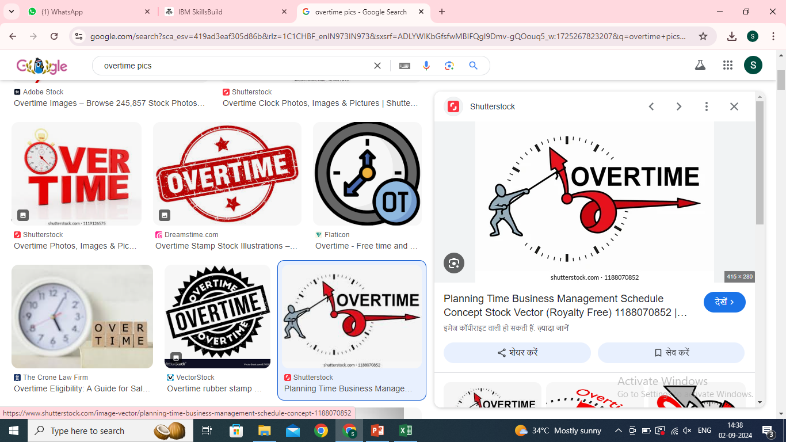
conclusion
The comparison for the overtime pay analysis, most employees done overtime and got the paid for this. These are the benefits for the employees and organization get the work completed by the day end. These benefits the organization, Employers, Employees, Human Resource Department.

Slide 14


